Slide 1
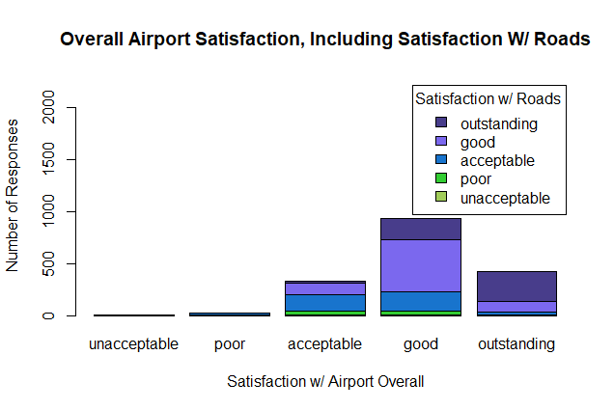
How do people’s perceptions of airport roads and signs impact their satisfaction with the airport overall?
HYPOTHESIS:
Airport roads/signage have a positive influence on overall customer satisfaction.
DATA:
2018 SFO Airport Customer Satisfaction Survey (scale of 1 to 5 for both variables)

Slide 2
Exploring the data
→ Distribution of each variable (frequency and relative frequency combined into one table)
→ Joint distribution table using “gmodel” package, break up into 4 separate tables, use contingency table to recreate first graph as a side-by-side bar graph, use 3rd table to display conditional proportion of overall satisfaction given satisfaction w/ roads
→ Generate random sample of 450 from dataset
→ Pearson chi-square test of independence using contingency table results in p-value of approx. 0, which indicates that they are statistically significantly associated, reject null hypothesis that they are independent
→ Obtain chi-square residuals and create a plot to visualize these residuals

Slide 3
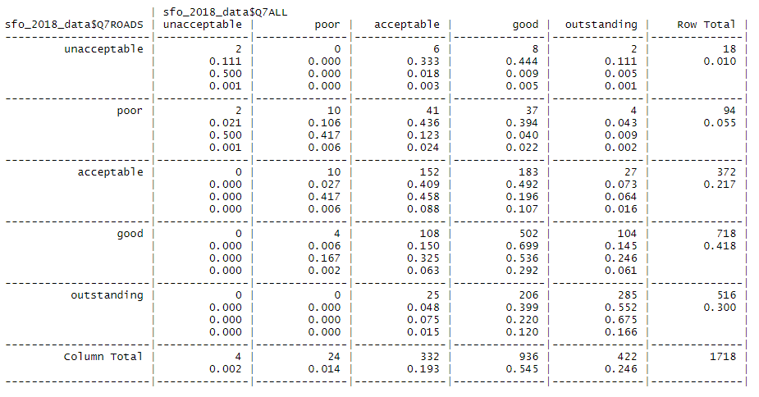

Slide 4
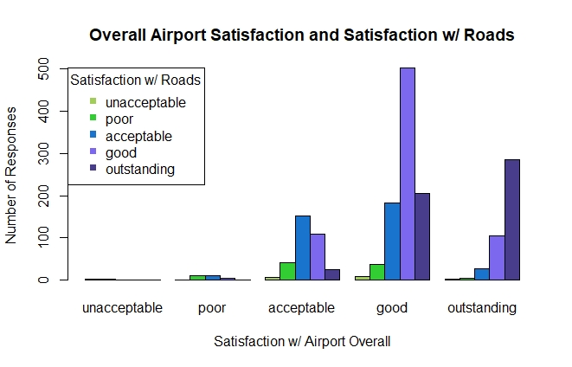
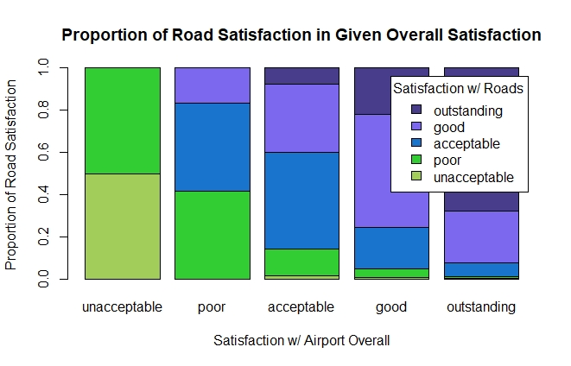
Results & limitations
RESULTS:
→ Based on the graphs generated, it seems there is a positive relationship between the two variables, almost linear relationship
→ See correlation plot
LIMITATIONS:
→ Data comes from only one source (SFO Airport)
→ Simpson’s Paradox
Notes:
Simpson’s Paradox = idea that a trend is apparent when two variables are being compared but disappears or in some cases even reverses when the independent variable is combined with another variable.

Slide 5
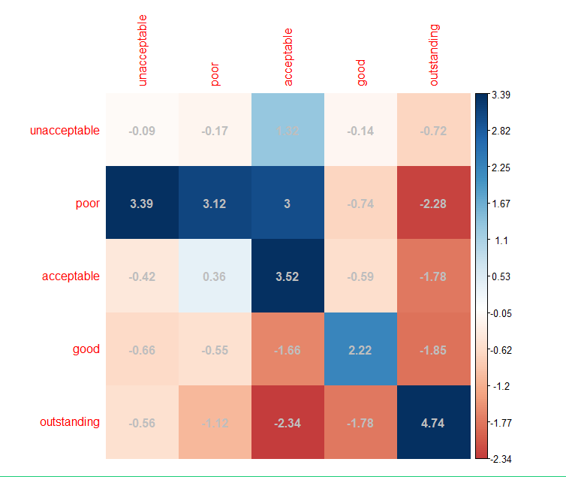
Correlation plot

